Slide 1
AI in Finance
General Applications of AI
Focus on Risk Scoring and Fraud Detection

Slide 2
Outline
Introduction to AI in Finance
Credit Risk Scoring and Credit Risk ML
Fraud Detection- AI Approached and Demo
Applications of AI in Finance by Companies
Ethical & Regulatory Considerations

Slide 3
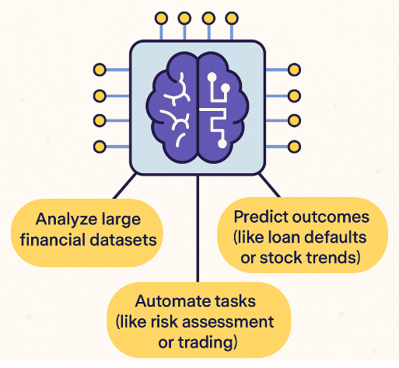

Introduction to AI in Finance
What is AI in Finance?
AI in Finance refers to the use of machine learning (ML), deep learning (DL), and data-driven automation to:
Analyze massive financial datasets: AI uncovers patterns and correlations across millions of transactions, customer profiles, and market signals.

Slide 4

Introduction to AI in Finance
What is AI in Finance?
AI in Finance refers to the use of machine learning (ML), deep learning (DL), and data-driven automation to:
Predict outcomes: Forecast credit defaults, detect fraud, and anticipate stock price movements or financial risks.

Slide 5

Introduction to AI in Finance
What is AI in Finance?
AI in Finance refers to the use of machine learning (ML), deep learning (DL), and data-driven automation to:
Automate financial tasks: Automates credit scoring, portfolio management, and algorithmic trading for improved efficiency and accuracy.

Slide 6
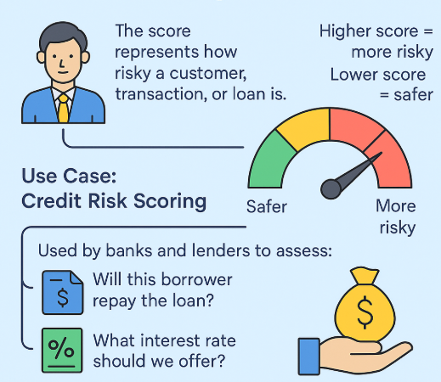

Risk Scoring
Risk Scoring in Finance is the process of assigning a numerical score to a borrower or financial transaction to quantify the likelihood of financial risk—such as loan default, fraud, or late payment.
What It Means:
The score represents how risky a customer, transaction, or loan is.
Higher score = more risky; lower score = safer.
Use Case: Credit Risk Scoring
Used by banks and lenders to assess:
Will this borrower repay the loan?
What interest rate should we offer?

Slide 7
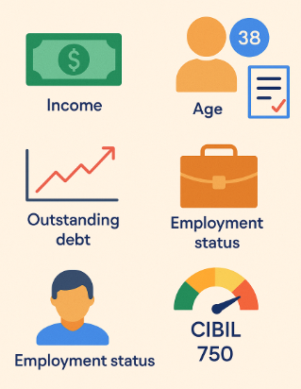
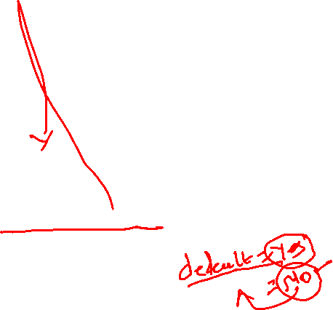
Risk Scoring
Inputs to Risk Scoring Models:
Income
Age
Credit history
Outstanding debt
Employment status
Credit score (e.g., CIBIL)
Credit Risk Models
Credit Risk Models are AI/ML algorithms designed to assess the probability that a borrower will default on a loan.

Slide 8
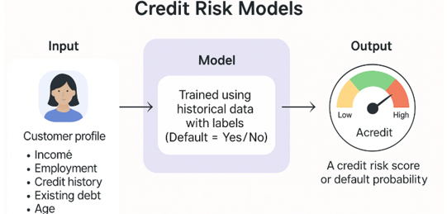
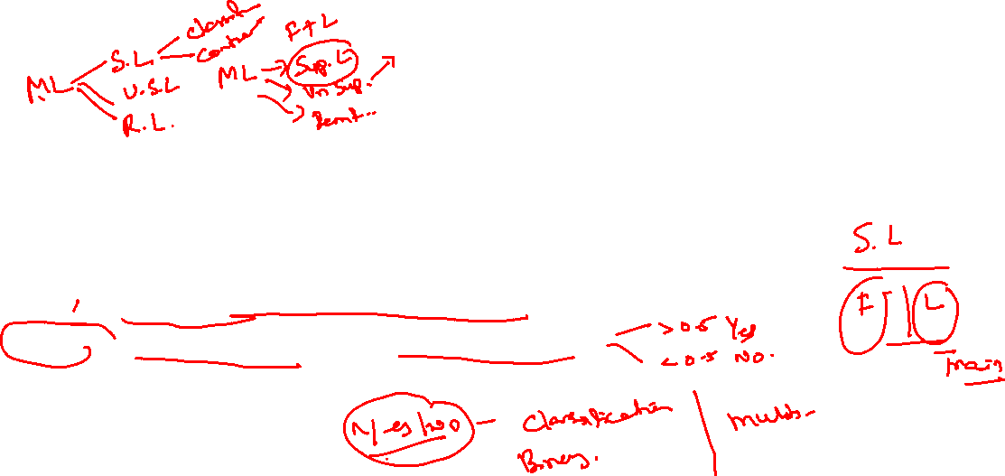
Risk Scoring
Credit Risk Models
How It Works:
Input: Customer profile data (e.g., income, employment, credit history, existing debt, age)
Model: Trained using historical data with labels (Default = Yes/No)
Output: A credit risk score or default probability
Goal: To classify or score applicants as low-risk or high-risk for better loan decision-making.

Slide 9
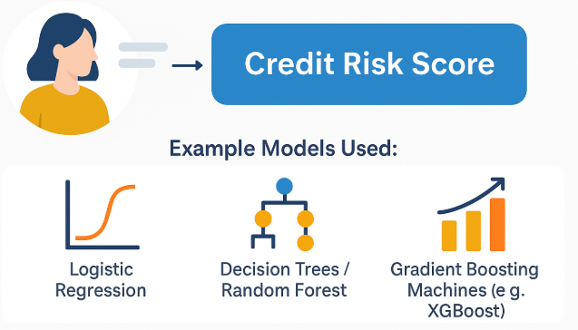

Risk Scoring
Credit Risk Models Predict default probability based on customer profile
Example Models Used:
Logistic Regression
Decision Trees / Random Forest
Gradient Boosting Machines (e.g., XGBoost)

Slide 10

Visual Walkthrough: Credit Risk
Credit Risk Scoring
Load user input: income, age, credit score, existing loan
Pre-trained model (e.g., Logistic Regression or Random Forest)
Output:
Score: 0.87 → High Risk → Loan Rejected
OR: Score: 0.22 → Low Risk → Loan Approved

Slide 11
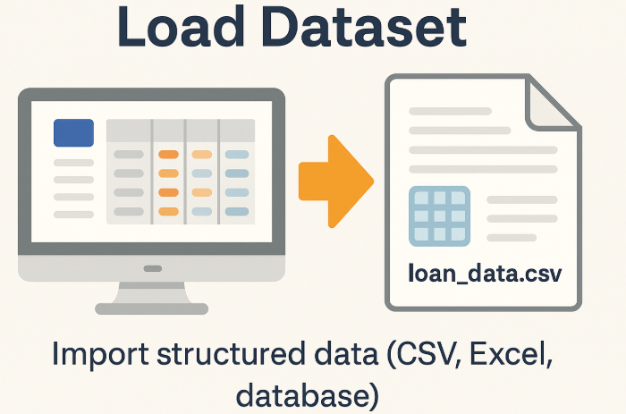
Visual Walkthrough: Credit Risk
Credit Risk ML Step-by-step demo:
Load dataset
Preprocess (scale, encode)
Train (e.g., Logistic Regression, Random Forest)
Predict
Load Dataset
Import structured data (CSV, Excel, database)
Example: loan_data.csv with features like income, age, loan amount, etc.

Slide 12
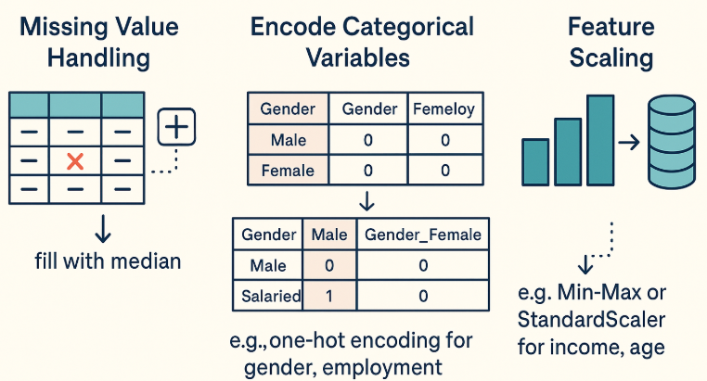
Visual Walkthrough: Credit Risk
Credit Risk ML Step-by-step demo:
Load dataset
Preprocess (scale, encode)
Train (e.g., Logistic Regression, Random
Forest)
Predict
Preprocess
Missing Value Handling (e.g., fill with median)
Encode Categorical Variables (e.g., one-hot encoding for gender, employment)
Feature Scaling (e.g., Min-Max or StandardScaler for income, age)

Slide 13
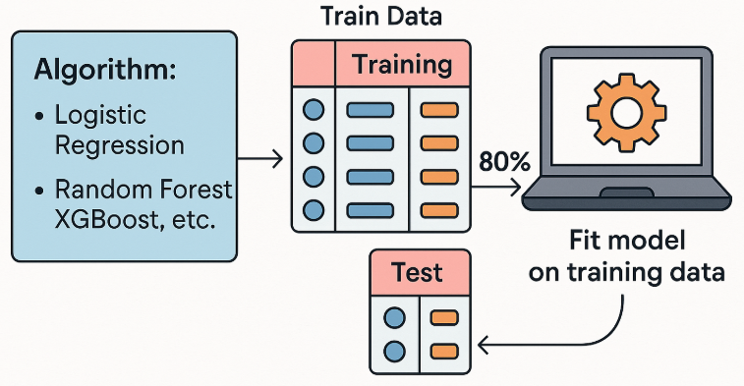
Visual Walkthrough: Credit Risk
Credit Risk ML Step-by-step demo:
Load dataset
Preprocess (scale, encode)
Train (e.g., Logistic Regression, Random Forest)
Predict
Train Model
Choose algorithm:
Logistic Regression
Random Forest
XGBoost, etc.
Split into train/test (e.g., 80/20) and Fit model on training data

Slide 14
Visual Walkthrough: Credit Risk
Credit Risk ML Step-by-step demo:
Load dataset
Preprocess (scale, encode)
Train (e.g., Logistic Regression, Random Forest)
Predict
Predict
Make predictions on test data
Output:
Class (default / no default)
Or probability (p(default) = 0.72)

Slide 15
Visual Walkthrough: Credit Risk
Credit Risk ML Step-by-step demo:
Load dataset
Preprocess (scale, encode)
Train (e.g., Logistic Regression, Random Forest)
Predict and Model Evaluation
Model Evaluation
Accuracy, Precision, Recall
Confusion Matrix
ROC-AUC Curve

Slide 16
Fraud Detection
Fraud Detection in Finance refers to the use of data analysis, ML, and AI techniques to identify and prevent unauthorized, illegal, or suspicious financial activities.
Common types of fraud include:
Credit card fraud – Unauthorized use of someone’s credit/debit card.
Identity theft – Fraudsters use stolen personal information to open accounts or make purchases.
Loan fraud – Applying for loans with false or stolen identities.
Insurance fraud – Filing fake or exaggerated claims.
Insider trading – Using confidential information for financial gain.

Slide 17
Fraud Detection
Fraud Detection in Finance refers to the use of data analysis, ML, and AI techniques to identify and prevent unauthorized, illegal, or suspicious financial activities.
How AI Helps in Fraud Detection
Data Collection: Transaction history, user profile, device info, etc.
Feature Engineering: Identify behaviors like frequency, amount, location mismatch.
Model Training: Use supervised learning (with labeled fraud/not-fraud) or unsupervised learning (anomaly detection)
Real-time Scoring: Predict if a transaction is fraudulent before it completes.
Alerts & Actions: Flag or block the transaction, alert investigators.

Slide 18
Fraud Detection
Fraud Detection: Real-Time Alerts Flag unusual transactions using anomaly detection
How It Works:
Input: Transaction data (e.g., amount, location, time, frequency, device ID)
Model:
Supervised Learning (if past fraud labels exist)
Unsupervised Learning (for unknown/new fraud patterns)
Anomaly Detection (Isolation Forest, Autoencoders)
Output: Transaction flagged as Normal or Suspicious

Slide 19
Fraud Detection
Fraud Detection: Real-Time Alerts Flag unusual transactions using anomaly detection
Example Alerts:
Unusual location of purchase
Sudden large withdrawal
Repeated failed login attempts
Common Algorithms:
Logistic Regression (for known fraud types)
Isolation Forest / One-Class SVM (for anomaly detection)
Neural networks (for high-volume data patterns)

Slide 20
Fraud Detection
How AI Detects Fraud
Supervised Learning
Input: Historical transaction data labeled as “fraud” or “legit”
Model: Logistic Regression, Random Forest, XGBoost
Goal: Learn patterns from past fraud to flag similar future cases
Unsupervised Learning
Input: Unlabelled transaction data
Techniques: Clustering (e.g., K-Means), Autoencoders, Isolation Forest
Goal: Flag transactions that deviate from typical behavior

Slide 21
Fraud Detection
Anomaly Detection Logic
Build a profile of normal behavior for each user (amount, location, time)
Identify outliers (e.g., sudden ₹80,000 spent in a foreign country)
Flag as potential fraud
Real-Time Detection Features
Amount, IP/location, device type, transaction time
Velocity checks (too many transactions in short time)
Behavioral fingerprints

Slide 22
Demo: Fraud Detection
Demo: Fraud Detection
Simulate transaction data:
Amount, device, location, frequency
Pass to anomaly detection model (e.g., Isolation Forest)
Output:
Anomaly Score: 0.95 → Flagged as Fraud
OR: Anomaly Score: 0.05 → Legit Transaction

Slide 23
Key Use cases of AI in Finance
Robo-Advisors: Investment Guidance Algorithms suggest personalized portfolio
Robo-advisors use AI algorithms to recommend personalized investment portfolios based on user goals, risk tolerance, and financial status.
How It Works:
User Input: Age, income, savings, investment horizon, risk appetite
Model:
Uses modern portfolio theory (MPT)
Applies ML/DL to optimize asset allocation
Continuously learns from market data
Output: A customized portfolio recommendation and rebalancing strategy

Slide 24
Key Use cases of AI in Finance
Robo-Advisors: Investment Guidance Algorithms suggest personalized portfolio
Robo-advisors use AI algorithms to recommend personalized investment portfolios based on user goals, risk tolerance, and financial status.
Features:
Auto portfolio rebalancing
Tax-loss harvesting
Goal-based planning
AI Techniques Used:
Clustering to group investors by behavior
Reinforcement Learning for dynamic strategy adjustment
Recommendation algorithms (similar to Netflix/Spotify)

Slide 25
Key Use cases of AI in Finance
Customer Service: Chatbots & NLP Automate queries and support in banking app
Chatbots & Natural Language Processing (NLP)
AI-powered chatbots use NLP to understand and respond to customer queries in real time, enhancing support in apps and websites.
How It Works:
Input: Customer messages (typed or spoken)
AI Model:
NLP engines (e.g., BERT, GPT, Dialogflow)
Intent detection + entity recognition
Dialogue management (context-aware)
Output: Relevant response, action, or escalation to a human agent

Slide 26
Key Use cases of AI in Finance
Customer Service: Chatbots & NLP Automate queries and support in banking app
Common Use Cases:
Balance inquiries
Loan status checks
Fraud report handling
Password resets
Benefits:
24/7 support
Reduced operational costs
Faster response time
Scalability across thousands of users

Slide 27
Key Use cases of AI in Finance
Algorithmic Trading: Predictive Modeling Forecast stock movements using ML model
Algorithmic trading uses AI and ML models to predict price movements and automatically execute trades based on those predictions.
How It Works:
Input Data:
Historical stock prices
Technical indicators (e.g., moving averages)
News sentiment & social media signals
Model:
Supervised Learning (e.g., XGBoost, LSTM, Random Forest)
Time-Series Forecasting (ARIMA, Prophet, Deep Learning models)
Output: Predicted price trends → Buy/Sell signals → Auto-execution via trading bots

Slide 28
Key Use cases of AI in Finance
Algorithmic Trading: Predictive Modeling Forecast stock movements using ML model
Key Features:
High-frequency trading
Portfolio optimization
Market anomaly detection
Used By:
Hedge funds
Investment banks
Retail trading platforms (e.g., Robinhood, Zerodha AI tools)

Slide 29
Applications of AI in Finance
Credit Risk Scoring
Purpose: Predict if a loan applicant is likely to default.
Techniques: Logistic Regression, XGBoost, Neural Networks
Use Case:
Banks use AI to analyze income, age, credit history, etc.
Example: FICO, LendingClub

Slide 30
Applications of AI in Finance
Fraud Detection
Purpose: Detect suspicious or unauthorized transactions in real time.
Techniques: Anomaly Detection, Isolation Forests, Autoencoders, Random Forest
Use Case:
Credit card companies flag fraudulent purchases.
Example: Mastercard, Visa, PayPal

Slide 31
Applications of AI in Finance
Algorithmic Trading
Purpose: Use AI models to buy/sell financial assets automatically based on predictions.
Techniques: Time Series Forecasting, Reinforcement Learning
Use Case:
Hedge funds automate trading strategies.
Example: Two Sigma, QuantConnect, JP Morgan AI Labs

Slide 32
Applications of AI in Finance
Robo-Advisors
Purpose: Provide automated investment guidance to clients.
Techniques: Portfolio Optimization, Rebalancing Algorithms
Use Case:
Users input goals, and the system recommends investment plans.
Example: Betterment, Wealthfront, Schwab Intelligent Portfolios

Slide 33
Applications of AI in Finance
Customer Service (Chatbots & NLP)
Purpose: Automate support and interaction through natural language.
Techniques: NLP (e.g., BERT), Intent Detection, Sentiment Analysis
Use Case:
AI answers FAQs and executes tasks (e.g., check balance).
Example: Bank of America’s Erica, HSBC's Amy

Slide 34
Applications of AI in Finance
Document & Compliance Automation
Purpose: Process and extract information from contracts, invoices, etc.
Techniques: OCR, Computer Vision, NLP
Use Case:
Automating KYC, auditing, and regulatory reporting.
Example: Kofax, ABBYY, TruNarrative

Slide 35
Applications of AI in Finance
Insurance Underwriting
Purpose: Evaluate risk and set premiums for insurance applicants.
Techniques: Supervised Learning, Bayesian Models
Use Case:
AI evaluates driving records, claims history, etc.
Example: Lemonade, Progressive, Allianz

Slide 36
Applications of AI in Finance
Wealth Management
Purpose: Personalized investment strategies and risk-adjusted advice.
Techniques: Clustering, Risk Profiling, Recommendation Systems
Use Case:
Tailored advisory via mobile apps.
Example: Morgan Stanley WealthDesk, Charles Schwab AI

Slide 37
Applications of AI in Finance
Financial Forecasting
Purpose: Predict future revenue, expenses, and trends.
Techniques: LSTM, ARIMA, Prophet
Use Case:
Used for budgeting, planning, and stock market forecasting.
Example: IBM Planning Analytics, Oracle EPM

Slide 38
Applications of AI in Finance
AML (Anti-Money Laundering)
Purpose: Detect hidden money-laundering activities.
Techniques: Graph Analytics, Rule-Based + ML Hybrids
Use Case:
Identify hidden patterns in transaction chains.
Example: SAS AML, ThetaRay, ComplyAdvantage

Slide 39
Ethical & Regulatory Considerations
Ethical & Regulatory Considerations in AI for Finance
Bias in Credit Scoring
AI models may unintentionally discriminate against certain age, gender, race, or socioeconomic groups.
Example: Historical data reflecting societal bias → model replicates it.
Mitigation:
Use fairness-aware ML techniques
Regular auditing and model explainability

Slide 40
Ethical & Regulatory Considerations
Ethical & Regulatory Considerations in AI for Finance
Data Privacy & Regulations
Financial data is sensitive. AI systems must comply with:
GDPR (EU): Right to explanation, consent, erasure
CCPA (California): Transparency, opt-out of data sales
Enforce secure data storage, encryption, and limited access

Slide 41
Ethical & Regulatory Considerations
Ethical & Regulatory Considerations in AI for Finance
Explainability of Models
Stakeholders (customers, regulators) demand:
“Why was I denied a loan?”
Black-box models (deep learning) → challenge
Solutions:
Use interpretable models (e.g., logistic regression)
Apply explainability tools (e.g., SHAP, LIME)

Slide 42
THANK YOU

